Slide 1

Electronic Voting Machine GROUP 6
19CCE201- Microcontrollers and Interfacing Techniques – Term Project

Slide 2
INTRODUCTION
Our project utilises the concepts taught in the 19CCE201 Course like LED Blinking, Serial Communication using UART and LCD Configuration to create an Electronic Voting Machine.
The Voting Machine is created with the names of the registered candidates and the number of registered voters is predefined in the code.
A button is assigned to every candidate and acts as a Ballot that the voters use to cast their votes.
After the process of voting is completed, the winner is declared, and the vote count is displayed.

Slide 3

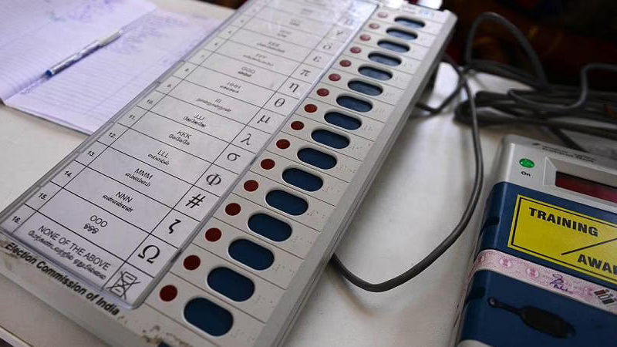
EVM

Slide 4
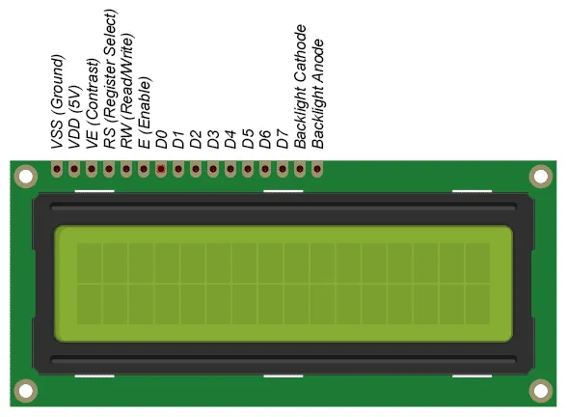
ALGORITHM
Initialise Header Files.
Create a function delay() that runs a nested loop to wait for a time.
Creating 2 functions TERMINAL_INIT() and LCD_INIT() to initialise the virtual terminal and LCD.
A function LCD_String() to print an array of characters.
Declaring and initialising the required variables.
Inside the main():
select the respective Port Pins and set them as Input/Output accordingly.
Using LSR, check if U0THR is not empty and then print the characters in Virtual Terminal.

Slide 5
For 'n' registered voters, display the candidates list.
Get the votes from each of the voters and add up the vote count for every candidate.
After the last vote is cast , run condition to check which candidate had the most votes.
Using UART0, transmit the details of the winner to the virtual terminal.

Slide 6
ASSUMPTIONS
The code assumes that the number of Registered Voters has been pre-determined by the Election Officers beforehand.
The assumed number of registered candidates contesting in the election is 4.
Additional blocks of code can be added in for every new candidate registered as per Election Commission Rules.
Provisions in the EVM are modified accordingly.
NOTA(NONE OF THE ABOVE) option available on the EVM is assumed to be Candidate 4 here.
Due Procedure regarding enforcement of Model Election Rules are followed.

Slide 7
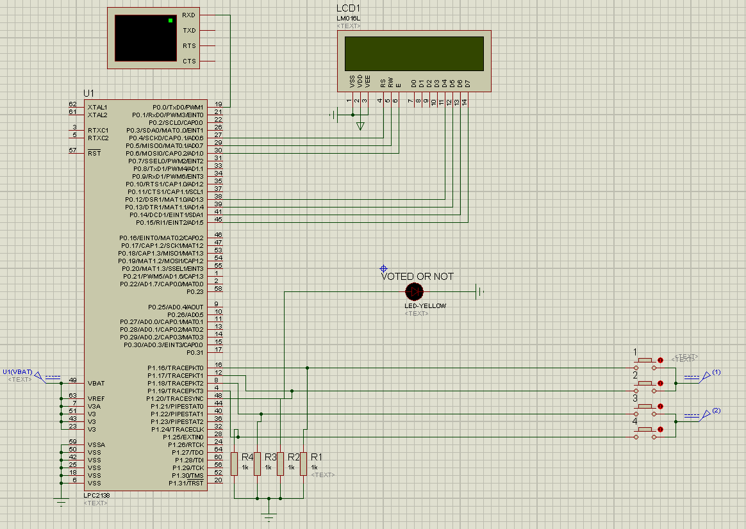
CIRCUIT DIAGRAM

Slide 8
LIMITATIONS AND SCOPE FOR IMPROVEMENT
More security procedures could be added in the code, verifying the authenticity of Counting Officers and preventing tampering of the EVM.
Since a 16x2 LCD is being used, the votes of all the candidates cannot be shown simultaneously.
Large number of candidates results in many buttons used, but the number of lines are fixed.
Votes of the candidates could be concealed in the LCD Display to prevent unnecessary influencing of voters.

Slide 9

THANK YOU!

